Slide 1

Your options in Data Science
Maximovsakaya
anastasia

Slide 2
A little about history
In the 1960s and 1970s, the American mathematician John W. Turkey published a series of papers where he suggested making hypotheses based on data.

Slide 3
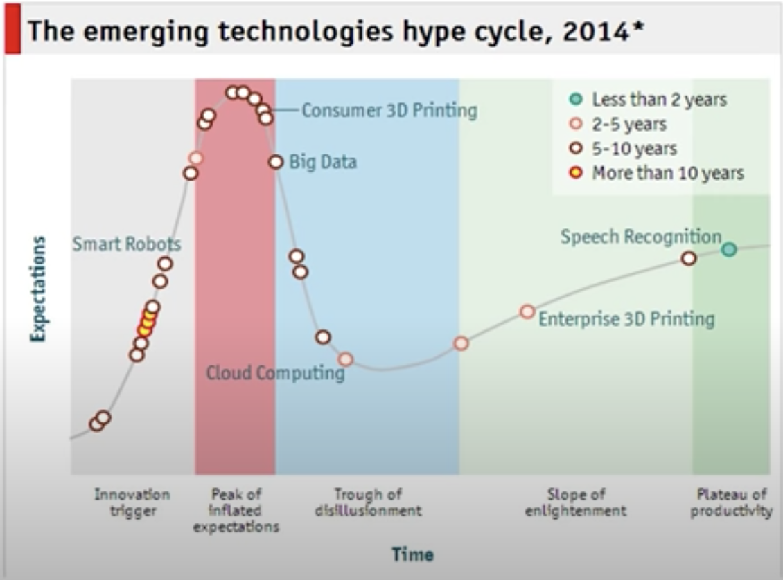
Gartner Hype Cycle 2014
In 2015, Gartner excluded the Big Data area. Why?

Slide 4
Do data scientists really exist?

Slide 6
Career tracks in DS
Notes:
Распределение дирихле, сопряженное распределение для мульиномиального, по факту – вероятность вероятности

Slide 7
Career tracks in DS
Notes:
Пример: в cs никто не ищзеи компьютерщиков – ищут фронт, бэк, мобилку

Slide 8
Top skills
Data mining
Data visualization
Python
Probability Theory and Statistics
Machine learning
Deep learning
SQL
Docker and containerization
Cloud services
Databases

Slide 9
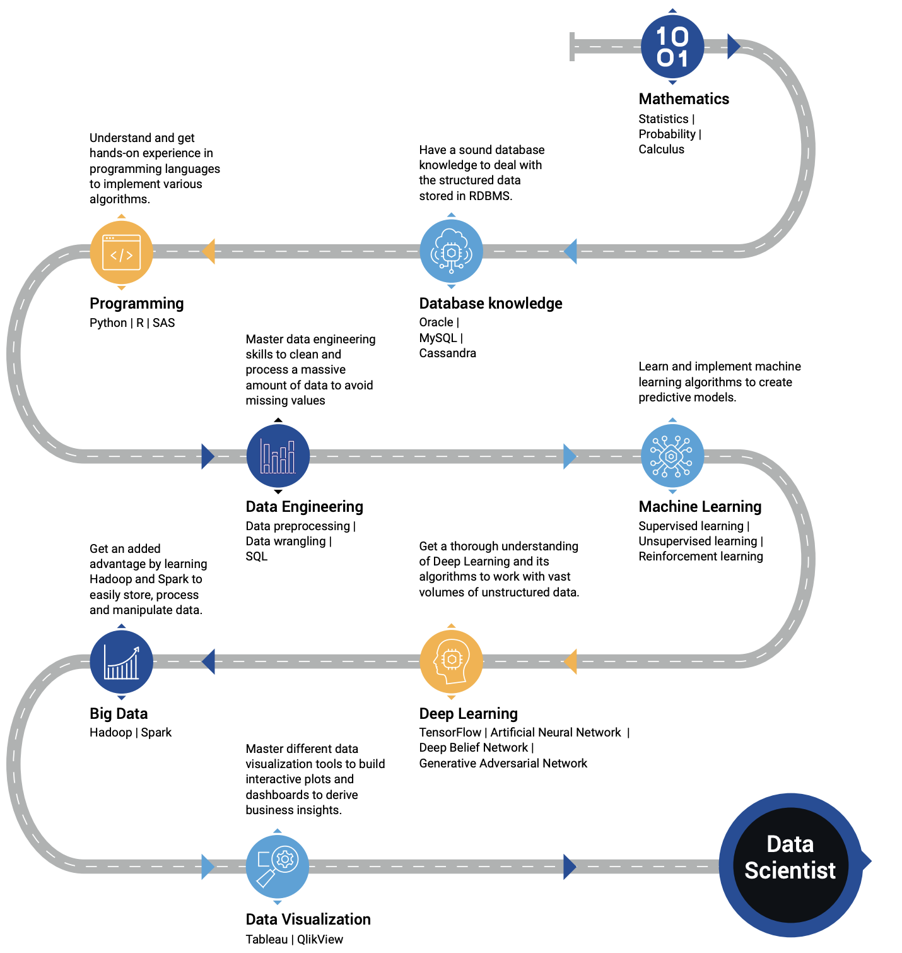

Slide 10
Terminology and interviews

Slide 11
ML system design intro
Problem statement
KPI and limitations
Baseline (heuristics or a simple model)
Defining the task
Data
Modelling
Metrics and validation
Problems
Deployment

Slide 12
Case study
The client is a restaurant chain that wants to open a new spot
Several accommodation options
You need to choose the one that will bring the most profit

Slide 13


Slide 14
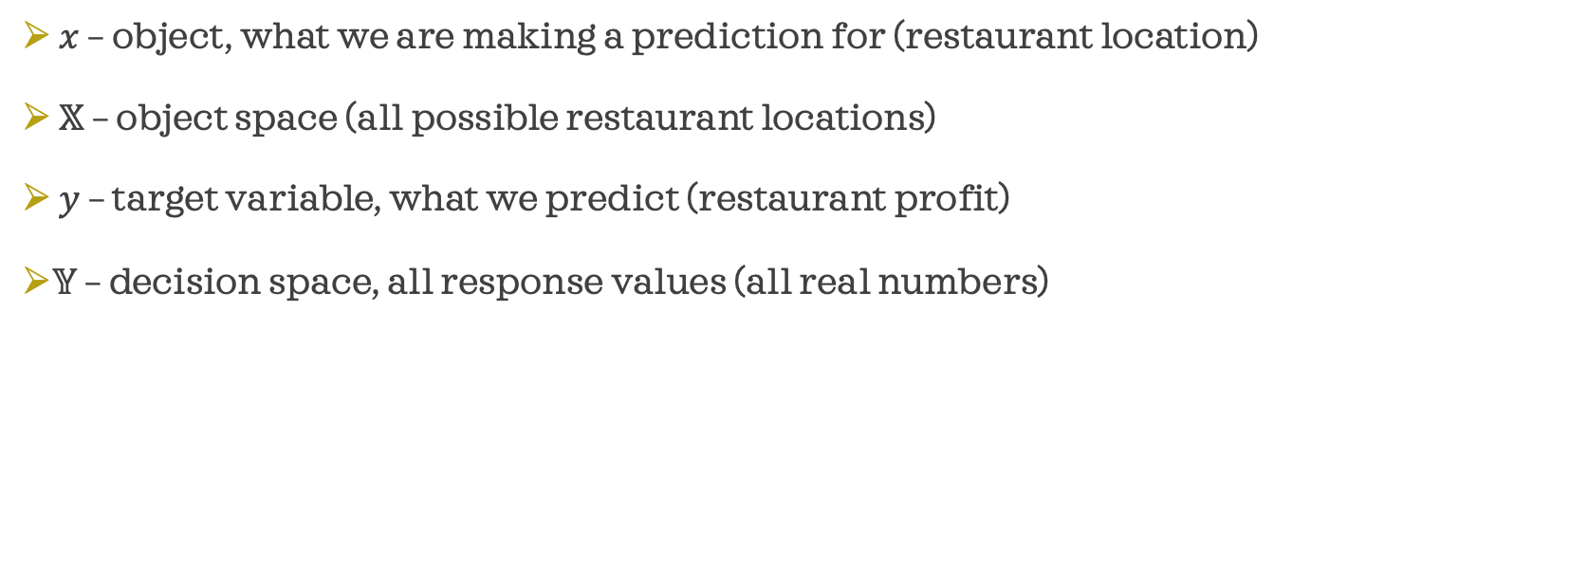
Case study
$x$ – object, what we are making a prediction for (restaurant location)
$𝕏$ – object space (all possible restaurant locations)
$y$ – target variable, what we predict (restaurant profit)
$𝕐$ – decision space, all response values (all real numbers)

Slide 15
Training sample
We collect many objects with a known value of the target variable
Existing restaurants, their indicative description and profit

Slide 16
Features
An object is an abstract entity, and computers work with numbers
Feature - the numerical characteristic of the object
Types of features:
Numeric
Binary (0/1)
Categorical
Features with a complex internal structure

Slide 17
Features
An object is an abstract entity, and computers work with numbers.
Features - the numerical characteristic of the object
What features should we collect for this task?

Slide 18
Possible answers
Location
Number of cars passing by per day
Distance to the nearest competitor
Average cost per square meter of housing nearby
The average age of residents of the nearest quarters
and so on

Slide 19
How to encode location data
We have coordinates - longitude and latitude
It is not very likely that there is a relationship between these two numbers and the target variable - profit
What should we do?

Slide 20
How to encode location data
We have coordinates - longitude and latitude
We generate features based on this data (feature generation)
What examples of features can you think of?

Slide 21
How to encode location data
We have coordinates - longitude and latitude
We generate features based on this data (feature generation)
Some examples:
distance from the city center, from the nearest metro station
if restaurants in different countries - time zones
and so on

Slide 22
Modelling
𝑎(𝑥) – algorithm, model (a function that predicts the answer for any object)
Maps 𝕏 to 𝕐 (object space to decision space)

Slide 23
Metrics
After the previous steps, we have a model that produces profit predictions for restaurants.
Now it is necessary to evaluate the quality of the obtained predictions
For this, metrics are used - measures of the quality of the algorithm on the sample
Selected based on business requirements

Slide 24
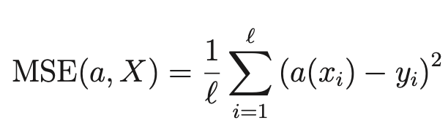
Example of a metric for regression
Mean Squared Error:
The less the better

Slide 25
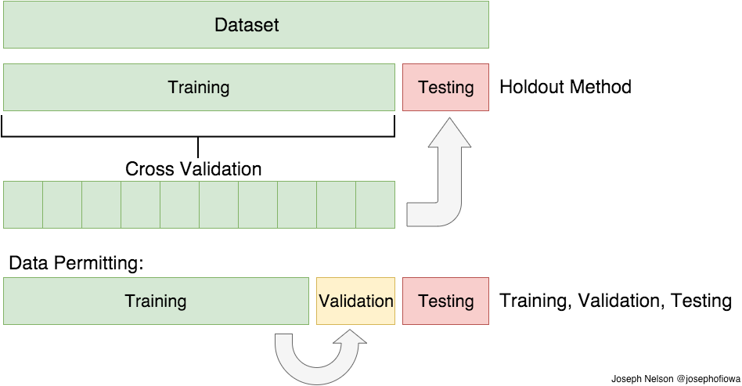
Validation

Slide 26
Training the model
Training is a search for the optimal algorithm in terms of quality
Having a training sample and a quality functional (metric), we select an appropriate algorithm from a certain family of algorithms
Important criteria: quality that meets business requirements, sustainability of results, in some cases - interpretability

Slide 27
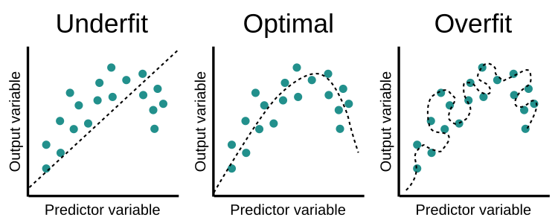
Overfitting and underfitting

Slide 28
Data science project lifecycle
Definition of the task and target metric
Data collection
Data preprocessing and EDA (exploratory data analysis)
Generation of additional features
Selection and validation of models
As a rule, return to point 2 or 3

Slide 30
Regression
Regression is a class of supervised learning problems, when it is necessary to predict the target variable for a certain set of object features.
The task of regression is to find dependencies between defining variables and the defined variable if it is a continuous number. For example, to determine the cost of a house by its area.
The target value is any real number.
The task of linear regression is to find such a relationship if it is linear.

Slide 31
Classification
Classification is a class of supervised learning tasks, when, according to a certain set of features of an object, it is necessary to predict its belonging to a certain class.
The task of classification is to find dependencies between defining variables and the defined variable, if it belongs to a fixed set of values. For example, to determine whether a person will return a loan or not (binary classification) or to determine the scientific field of an article (multi-class classification).
The target value is a class (one from a fixed set).
There is also a multiclass classification with overlapping classes.

Slide 32
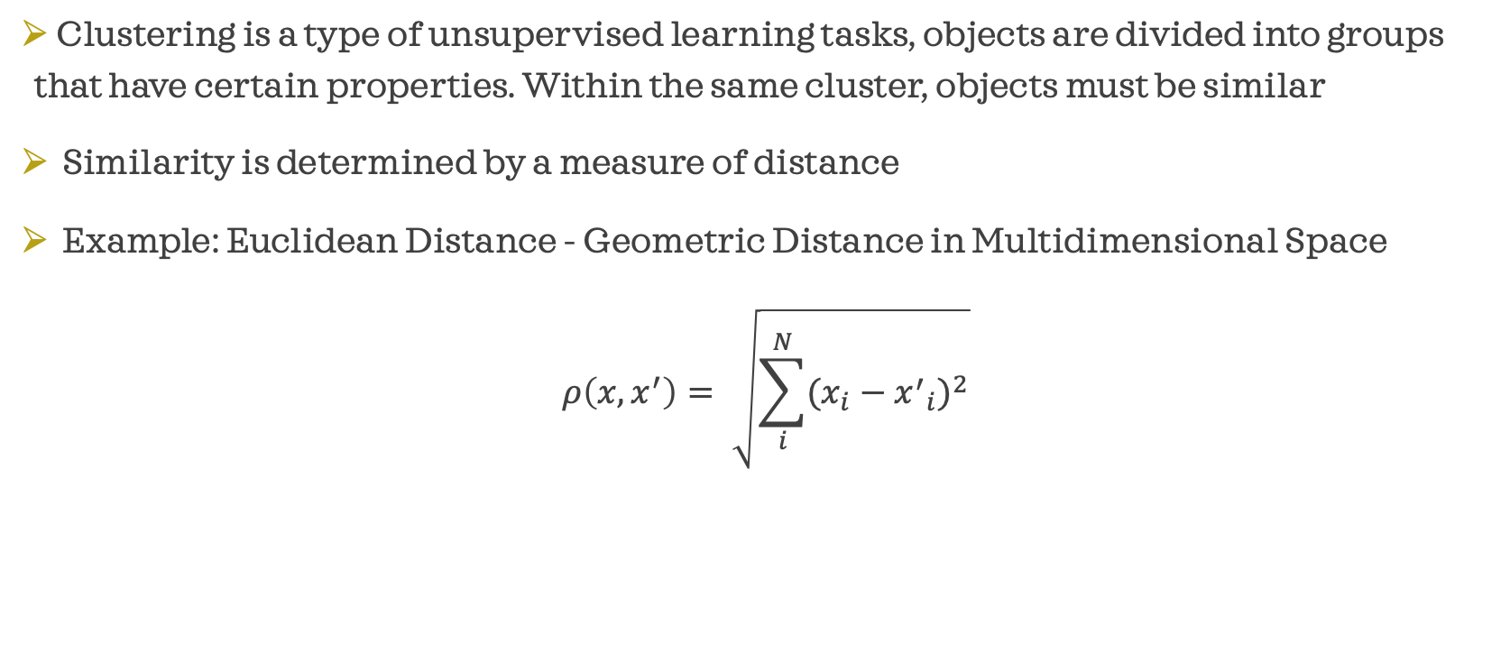
Clustering
Clustering is a type of unsupervised learning tasks, objects are divided into groups that have certain properties. Within the same cluster, objects must be similar
Similarity is determined by a measure of distance
Example: Euclidean Distance - Geometric Distance in Multidimensional Space
$$ρ\left(x, x^{′}\right)= \sqrt{\sum_{i}^{N}{{(x_{i}−{x^{′}}_{i})}^{2}}}$$

Slide 33
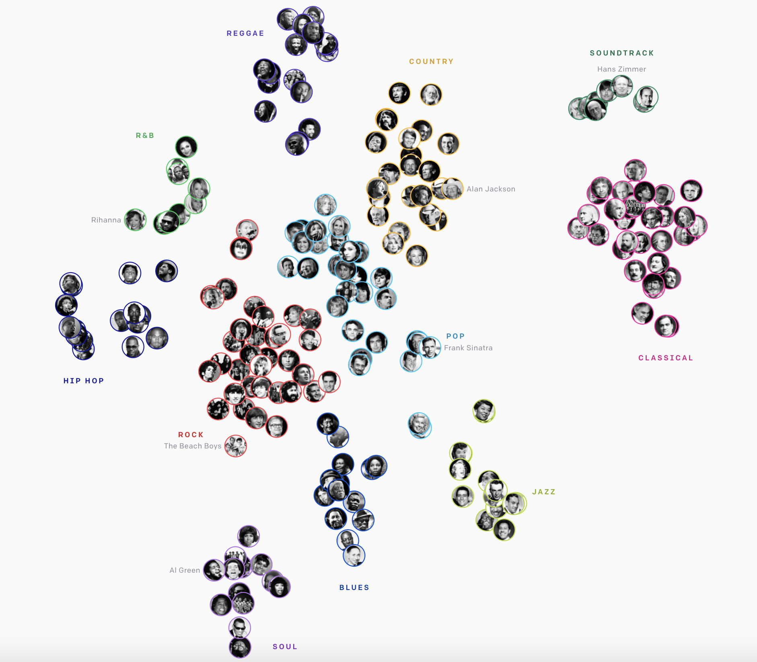
Example
https://openai.com/blog/jukebox/

Slide 35
Specializations

Slide 36
Recommender systems
We predict what will be interesting to the user based on information about his profile
Examples: Netflix, Amazon, Youtube

Slide 37
NLP – Natural Language Processing
Working with natural language

Slide 38
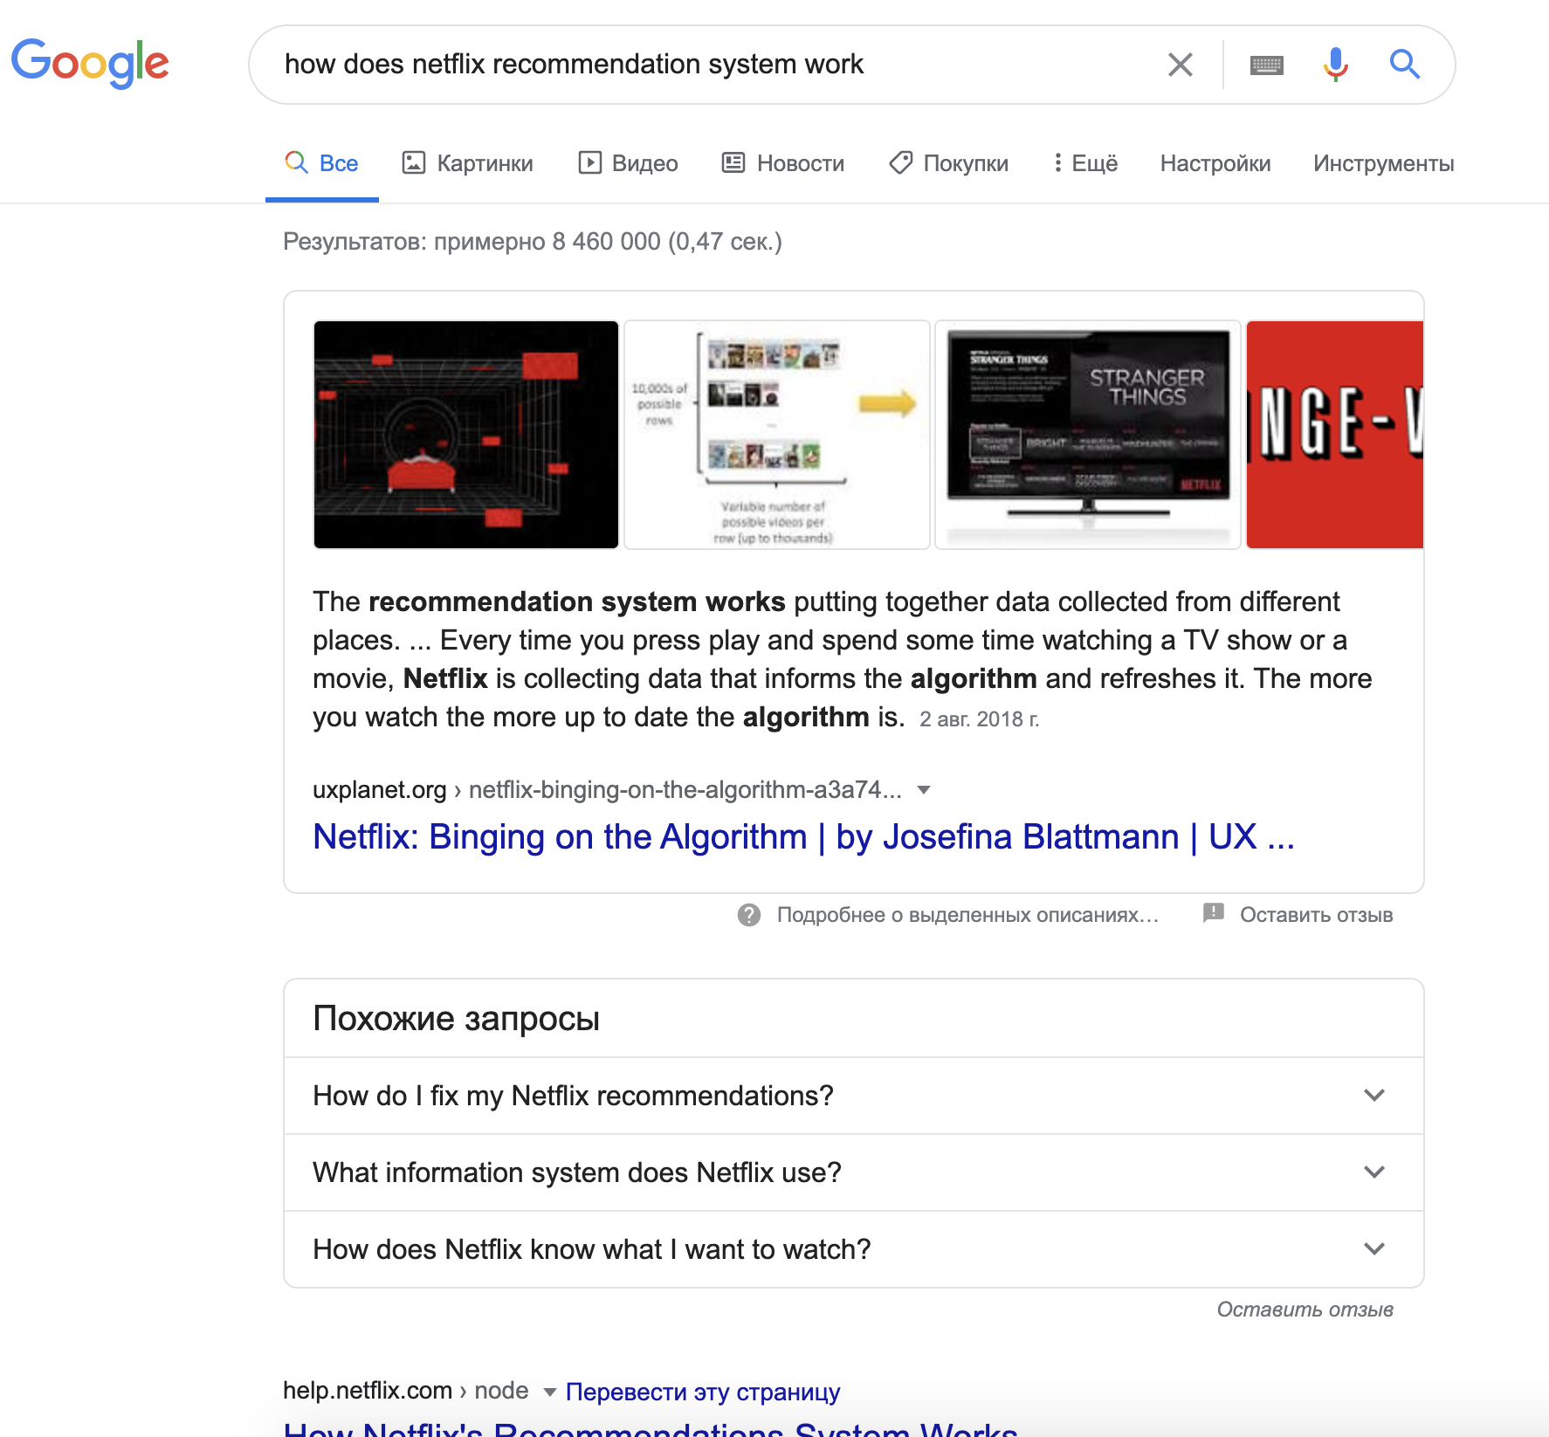
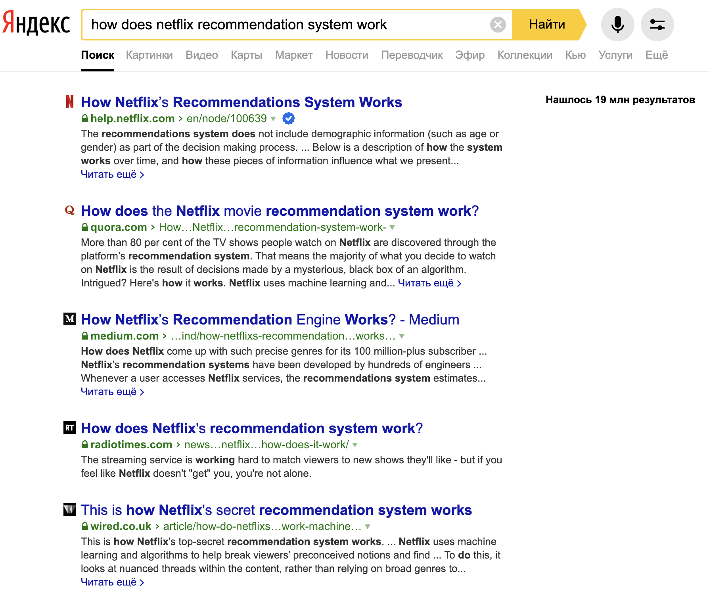
NLP + ranking

Slide 39
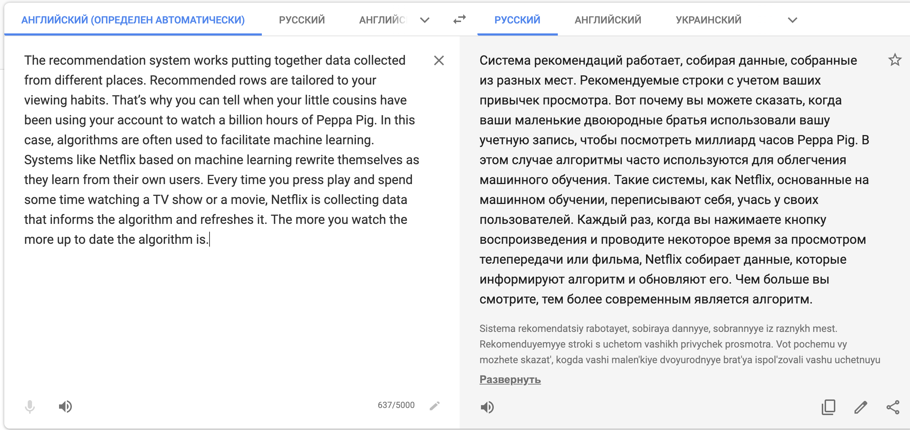
NLP

Slide 40
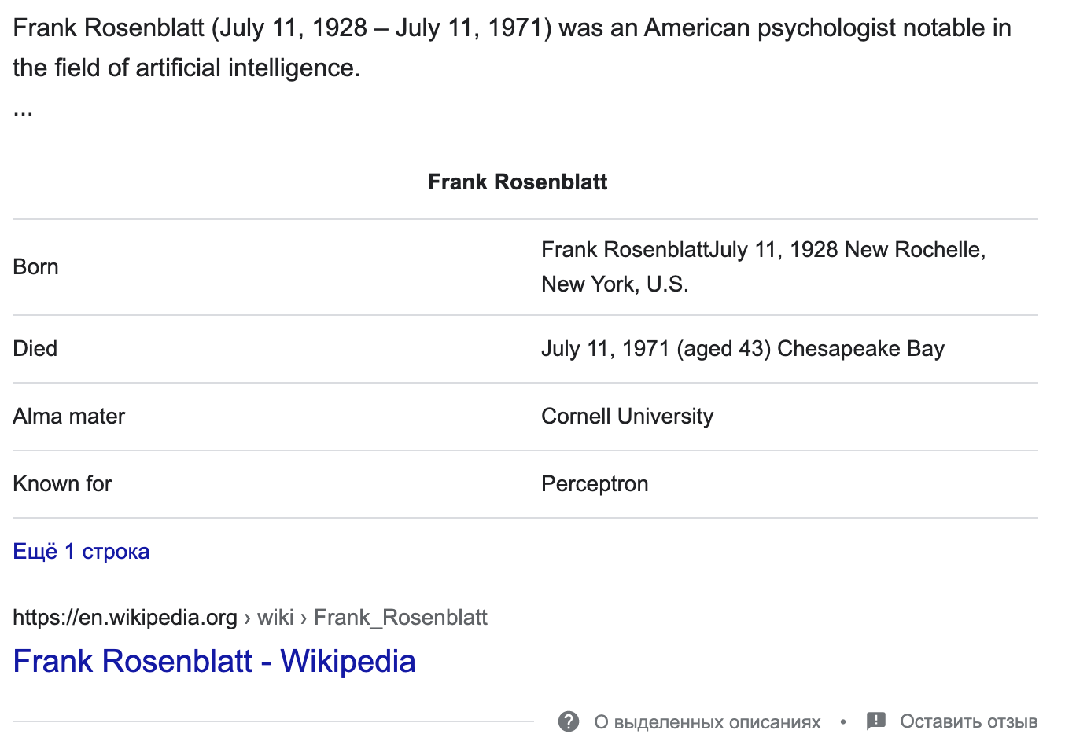
Information retrieval
In the request I wrote a name, in response I got a card with key information

Slide 41
NLP – Natural Language Processing
Machine translation, chat bots, spam filter, search engine suggestions
And in conjunction with speech recognition - Siri, Alexa

Slide 42
CV – computer vision
We want to understand what is happening in the image
Turing test for computer vision problems: answer any question about an image that a person can answer

Slide 43


Slide 44
CV applications

Slide 45
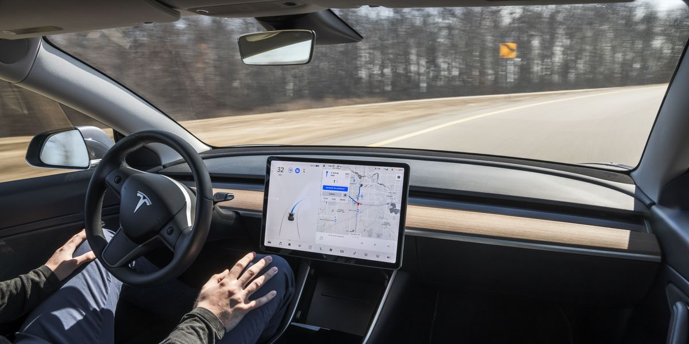
CV applications

Slide 46
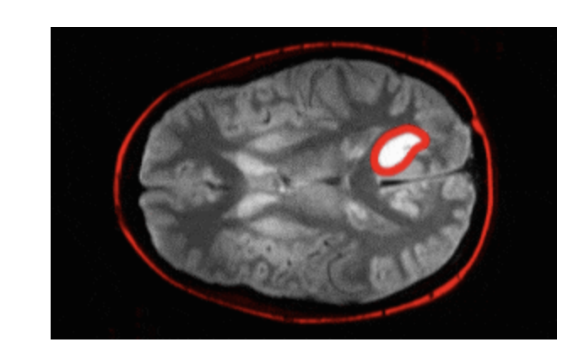
CV applications
Detection of a brain tumor

